Slide 1
Project Round 2!

Slide 2
Project Two – Here we go!

Slide 3
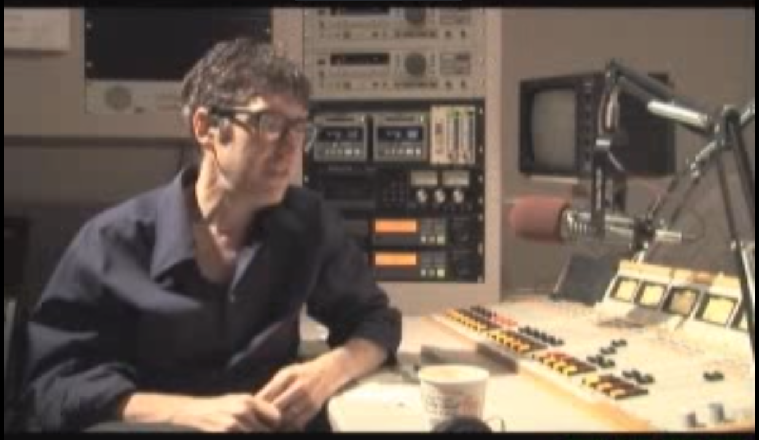
Ira Glass – On “Taste”
https://www.youtube.com/watch?v=X2wLP0izeJE

Slide 4
Your Challenge

Slide 5
Project Task
To build an awesome full stack application!

Slide 6
Your Challenge
At this point, you all have real skills.
It’s time to show it.

Slide 7
Your Challenge
Like seriously.
Be ambitious.

Slide 8
Project Week Overview

Slide 9
Project Week
Gameplan
Divide into groups
Begin assessing interests and skills
Begin researching “data-sets”
Outlining project ideas
Submitting Project Proposal for Approval
Initial Design work
Learn Testing
Do more Project Work

Slide 10
Teams

Slide 11
Group Teams
You get to pick your team, with one caveat, you cannot work with the group you worked with in the previous project. So time to step out of that comfort zone and find your new “tribe”.
Since this is small cohort, please keep teams between 3 – 4 people that you think you will work best with.
Good luck, have fun!

Slide 12
Coding Requirements
Must use a Node and Express Web Server
Must be backed by a MySQL Database with a Sequelize ORM
Must have both GET and POST routes for retrieving and adding new data
Must be deployed using Heroku (with Data)
Must utilize at least one new library, package, or technology that we haven’t discussed
Must have a polished frontend / UI
Must have folder structure that meets MVC Paradigm
Must meet good quality coding standards (indentation, scoping, naming)
Must protect API keys in node with environment variables.

Slide 13
Coding – Nice To Haves
Utilize Handlebars for Server-Side Templating
Incorporate Authentication (JSON Web Tokens, Sessions, Etc.)
Use an existing public dataset to power the database
Create a migration strategy for sharing data across team members e.g. using a seed/schema.sql file.

Slide 14
Presentation Requirement
You will also be responsible for preparing a 10 minute presentation.
This will be a formal presentation.
One in which you explain in detail:
Your overall application’s concept
The motivation for its development
Your design process
The technologies you used (and briefly how they work)
A demonstration of its functionality
Directions for future development
Treat the presentation seriously!
Talking intelligently about tech > doing tech sometimes.

Slide 15
Metrics

Slide 16
Metrics
Concept
Design
Functionality
Collaboration
Presentation

Slide 17
Questions

